Slide 1
Vehicle Tracking System
IN
Cement industries

Slide 2
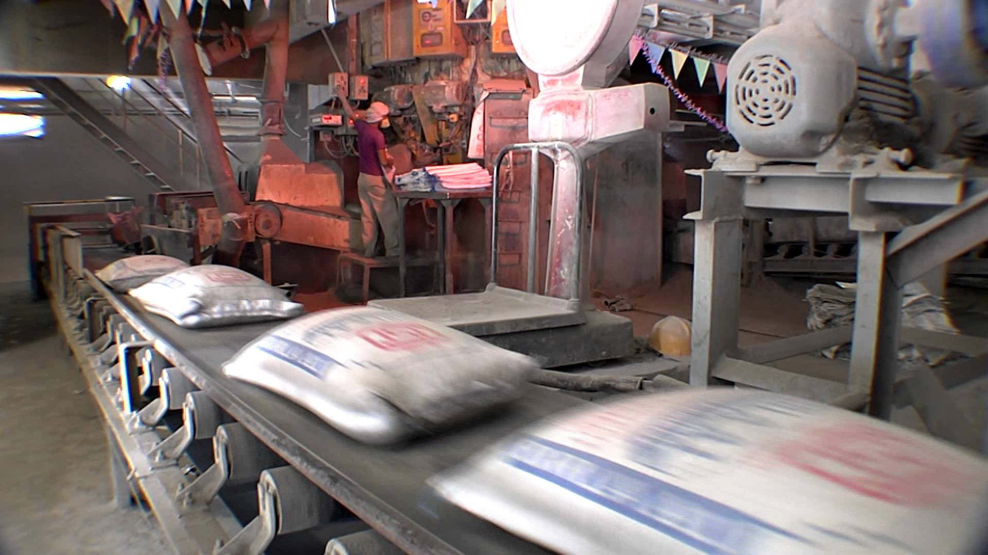
Current Problems
Manual System
More man power involved
Pilferage of materials
Verification of tonnage & Trips
Lack of visibility of vehicle movements

Slide 3
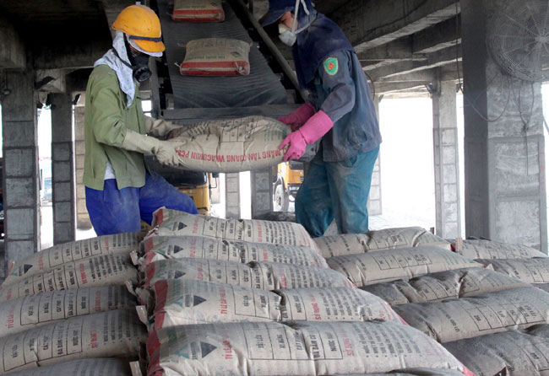
Objective
Ensure Data authenticity
Ensure Data accuracy
Reduction of manual effort
Identify pilferage
Verify Tonnage & trips
Increased productivity

Slide 4
Proposed Solution
RFID tagging
Each vehicle carrying ore will be fixed with a RFID tag with unique identification number
All truck details including the registration number, model, owner details, driver details etc will be fed to the application software

Slide 5
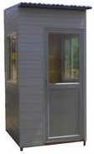
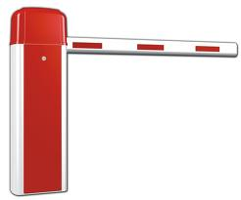
Proposed Solution
Security IN point
Empty trucks will first come to this point for entering inside Plant
RFID reader fixed on gate will read the tag on truck
Application software verify the truck identity and opens boom barrier
Truck enters the Plant

Slide 6
Proposed Solution
Tare Weight Point
Empty truck moves to the weighing balance for taking the tare weight
RFID reader at this point identifies the truck
Weight will be automatically transferred to the application software
Tare weight will be recorded in the application software for the truck

Slide 7
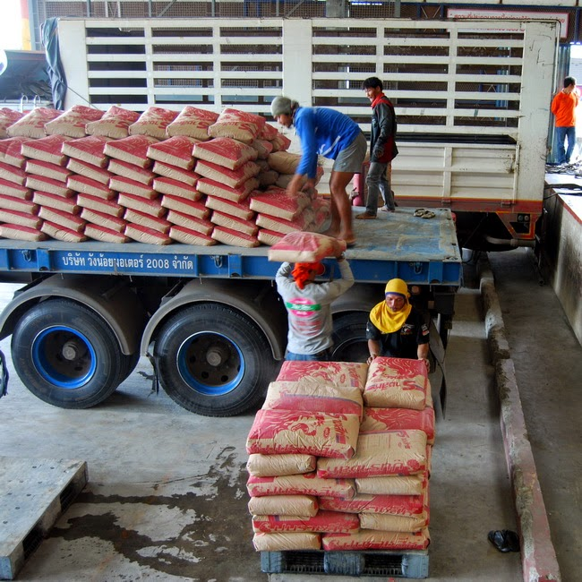
Proposed Solution
Loading point
Truck will be loaded with the Materials

Slide 8
Proposed Solution
Gross Weight Point
Loaded truck moves to the weighing balance for taking the gross weight
RFID reader at this point identifies the truck
Weight will be automatically transferred to the application software
Gross weight will be recorded in the application software for the truck
Net weight calculated by deducting tare weight

Slide 9
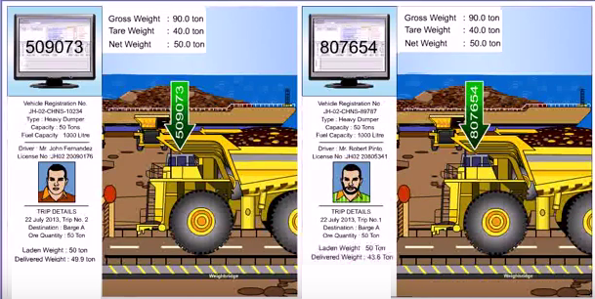
Proposed Solution
Gross Weight Point

Slide 10
Proposed Solution
Security OUT point
Loaded trucks will come to this point for going outside
RFID reader fixed on gate will read the tag on truck
Application software verify the truck identity and opens boom barrier
Truck leaves the plant

Slide 11
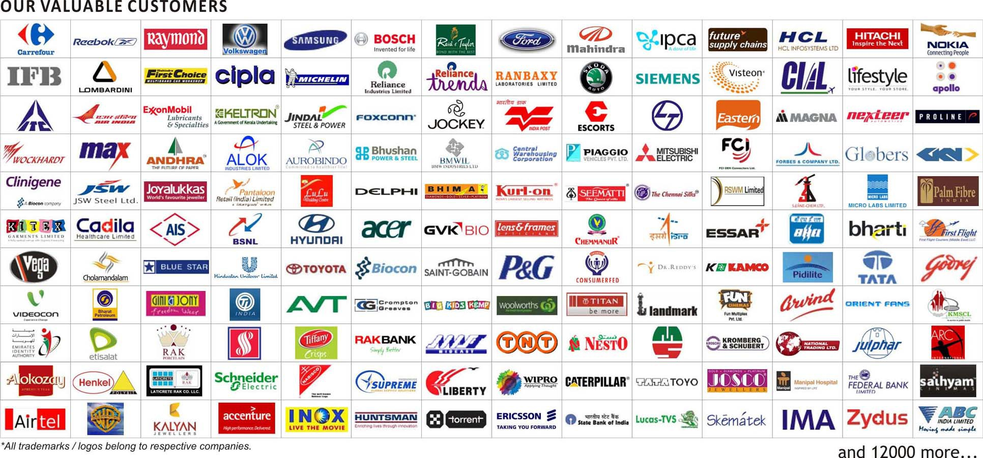

Slide 12
STALLION SYSTEMS AND SOLUTIONS PVT LTD. Stallion House, Padam Stop, KP Vallon Road
Kadavanthra, Kochi, 682020
www.stallionindia.com
Email : sales@stallionindia.com
Thank You !

